Slide 1
ECE 884 Deep Learning
Lecture 12: Training Neural Networks
03/04/2021

Slide 2
Review of last lecture
Backward Propagation (Backpropagation)

Slide 3
Today’s lecture
Deep Neural Network Training Pipeline
Data preprocessing
Regularization for Neural Networks
Learning Rate Schedules
Notes:
To add:
Weight initialization
Batch normalization

Slide 4
Data Preprocessing

Slide 5
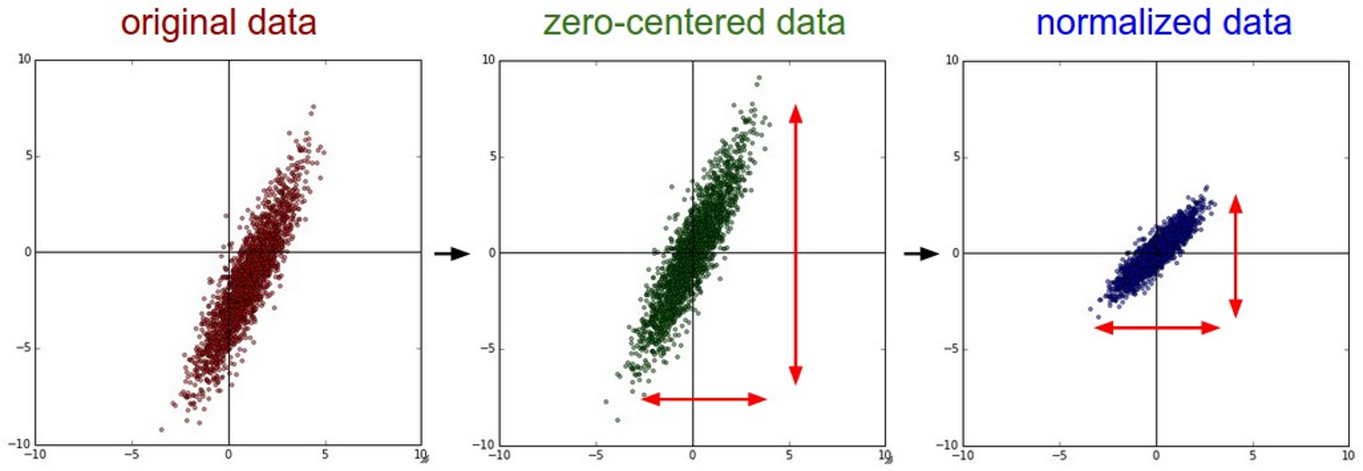
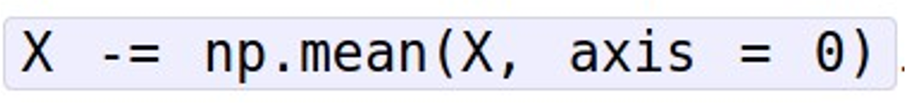
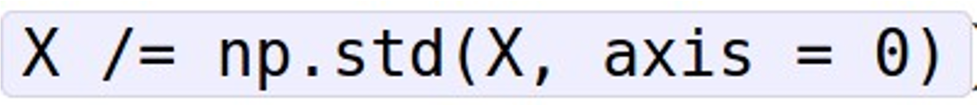
Data Preprocessing

Slide 6
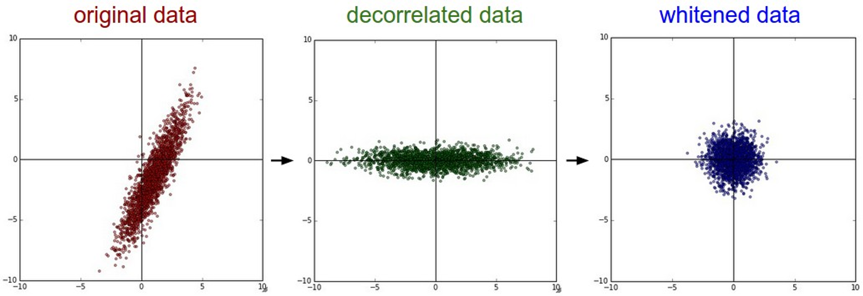
Data Preprocessing
In practice, you may also see PCA and Whitening of the data
(data has diagonal covariance matrix)
(covariance matrix is the identity matrix)

Slide 7



Data Preprocessing
Before normalization: classification loss very sensitive to changes in weight matrix; hard to optimize
After normalization: less sensitive to small changes in weights; easier to optimize

Slide 8
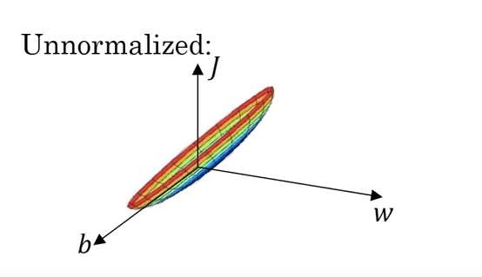
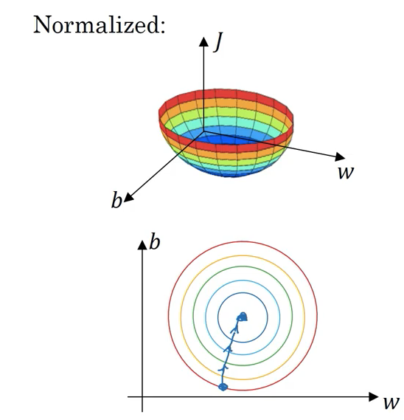
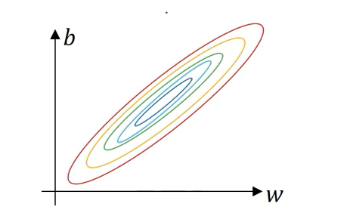
Data Preprocessing

Slide 9
Regularization for Neural Networks

Slide 10
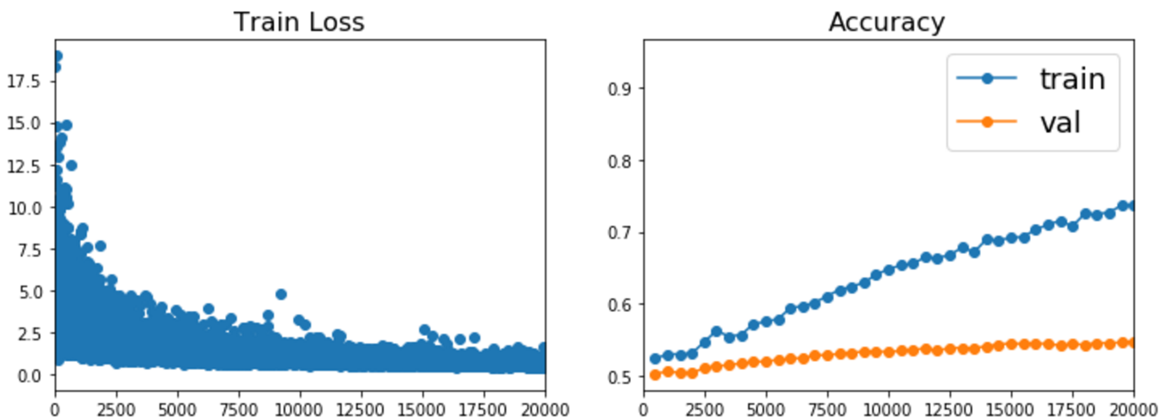
Regularization for Neural Networks

Slide 11
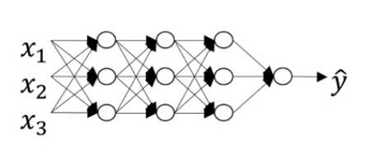
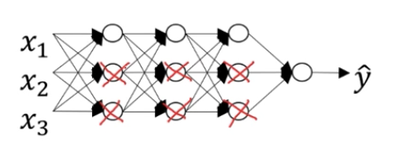
Regularization: Penalize Neural Network Complexity

Slide 12
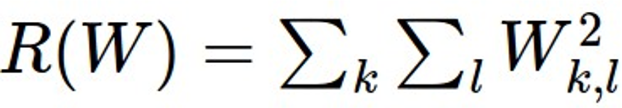
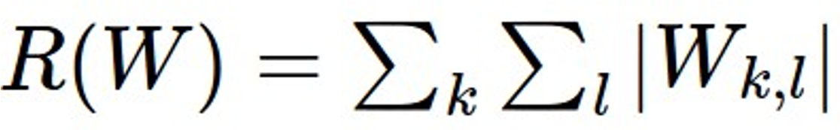
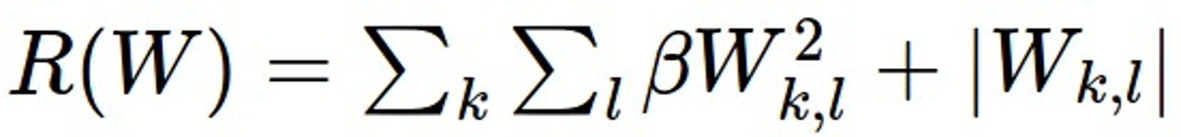
Regularization#1: Add term to the loss
In common use: L2 regularization L1 regularization
Elastic net (L1 + L2)
(Weight decay)

Slide 13
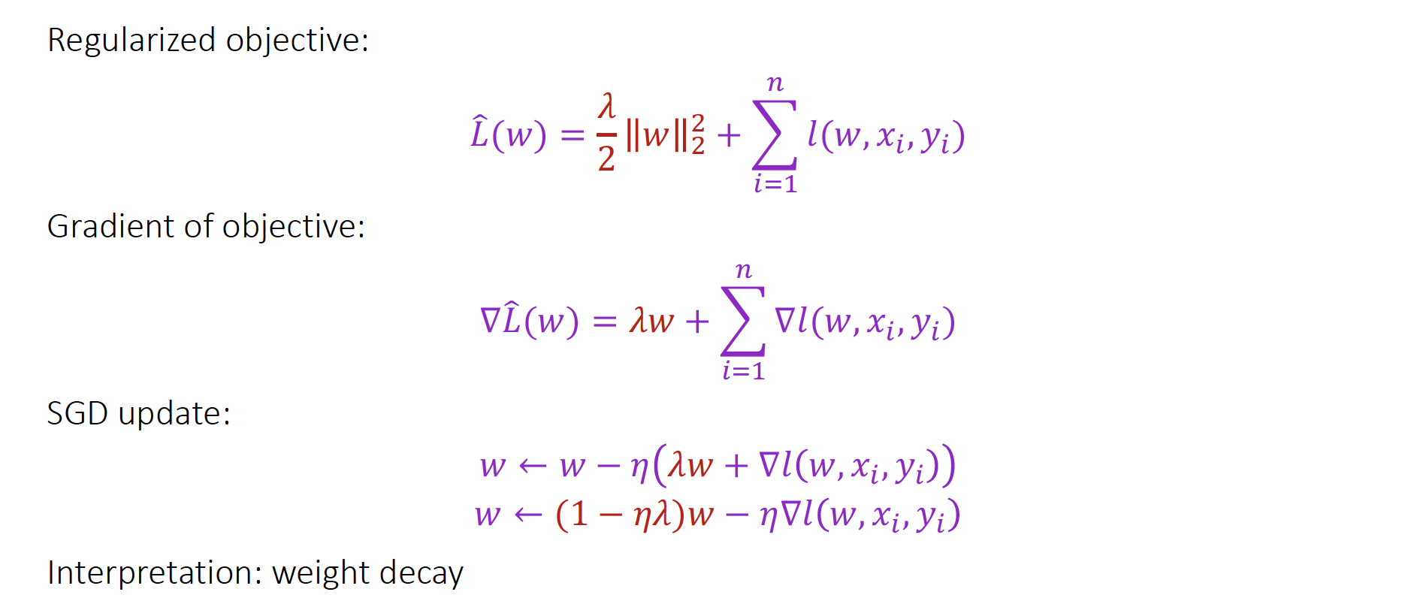
L2 Regularization for DNN

Slide 14
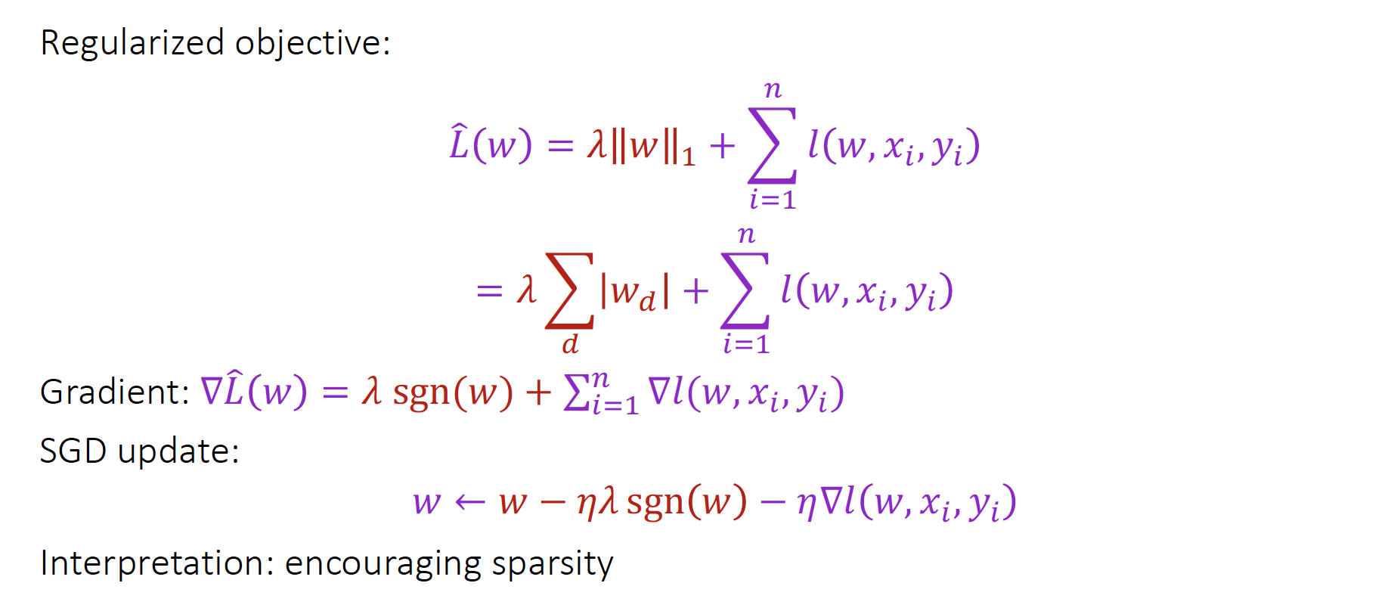
L1 Regularization for DNN

Slide 15
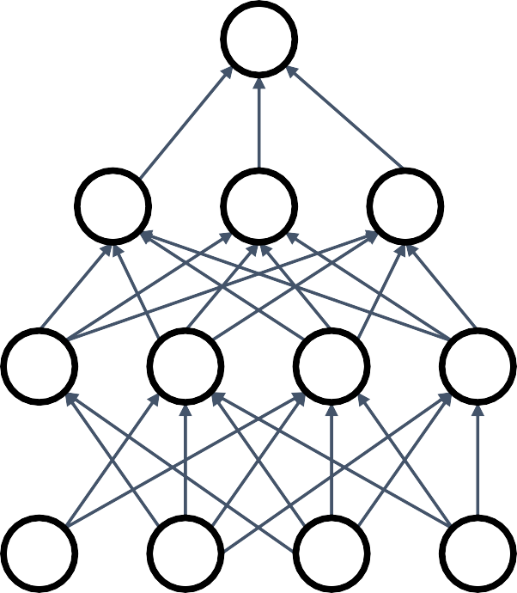



Regularization#2: Dropout
In each forward pass, randomly set some neurons to zero Probability of dropping is a hyperparameter; 0.5 is common

Slide 16
Dropout Interpretations
Interpretations:
#1: Can’t reply on any one feature. Spread out the weights, similar to L2 regularization.
#2: Dropout is training a large ensemble of models (that share parameters).

Slide 17
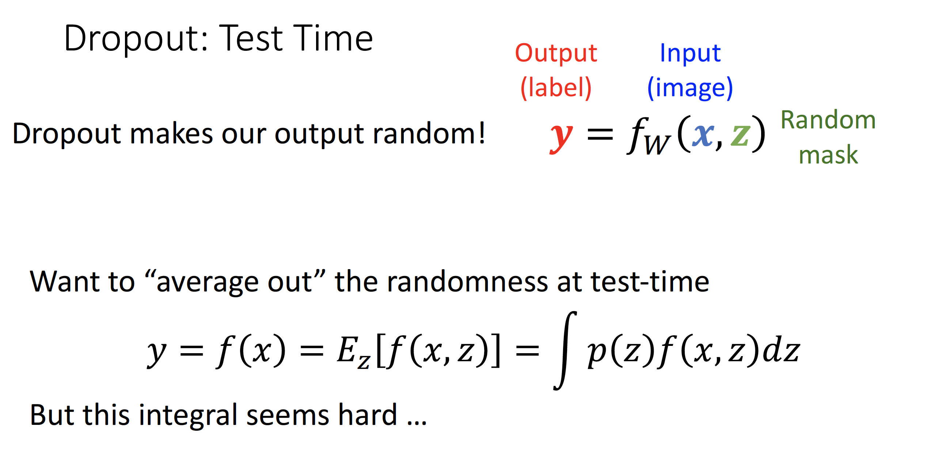

Slide 18
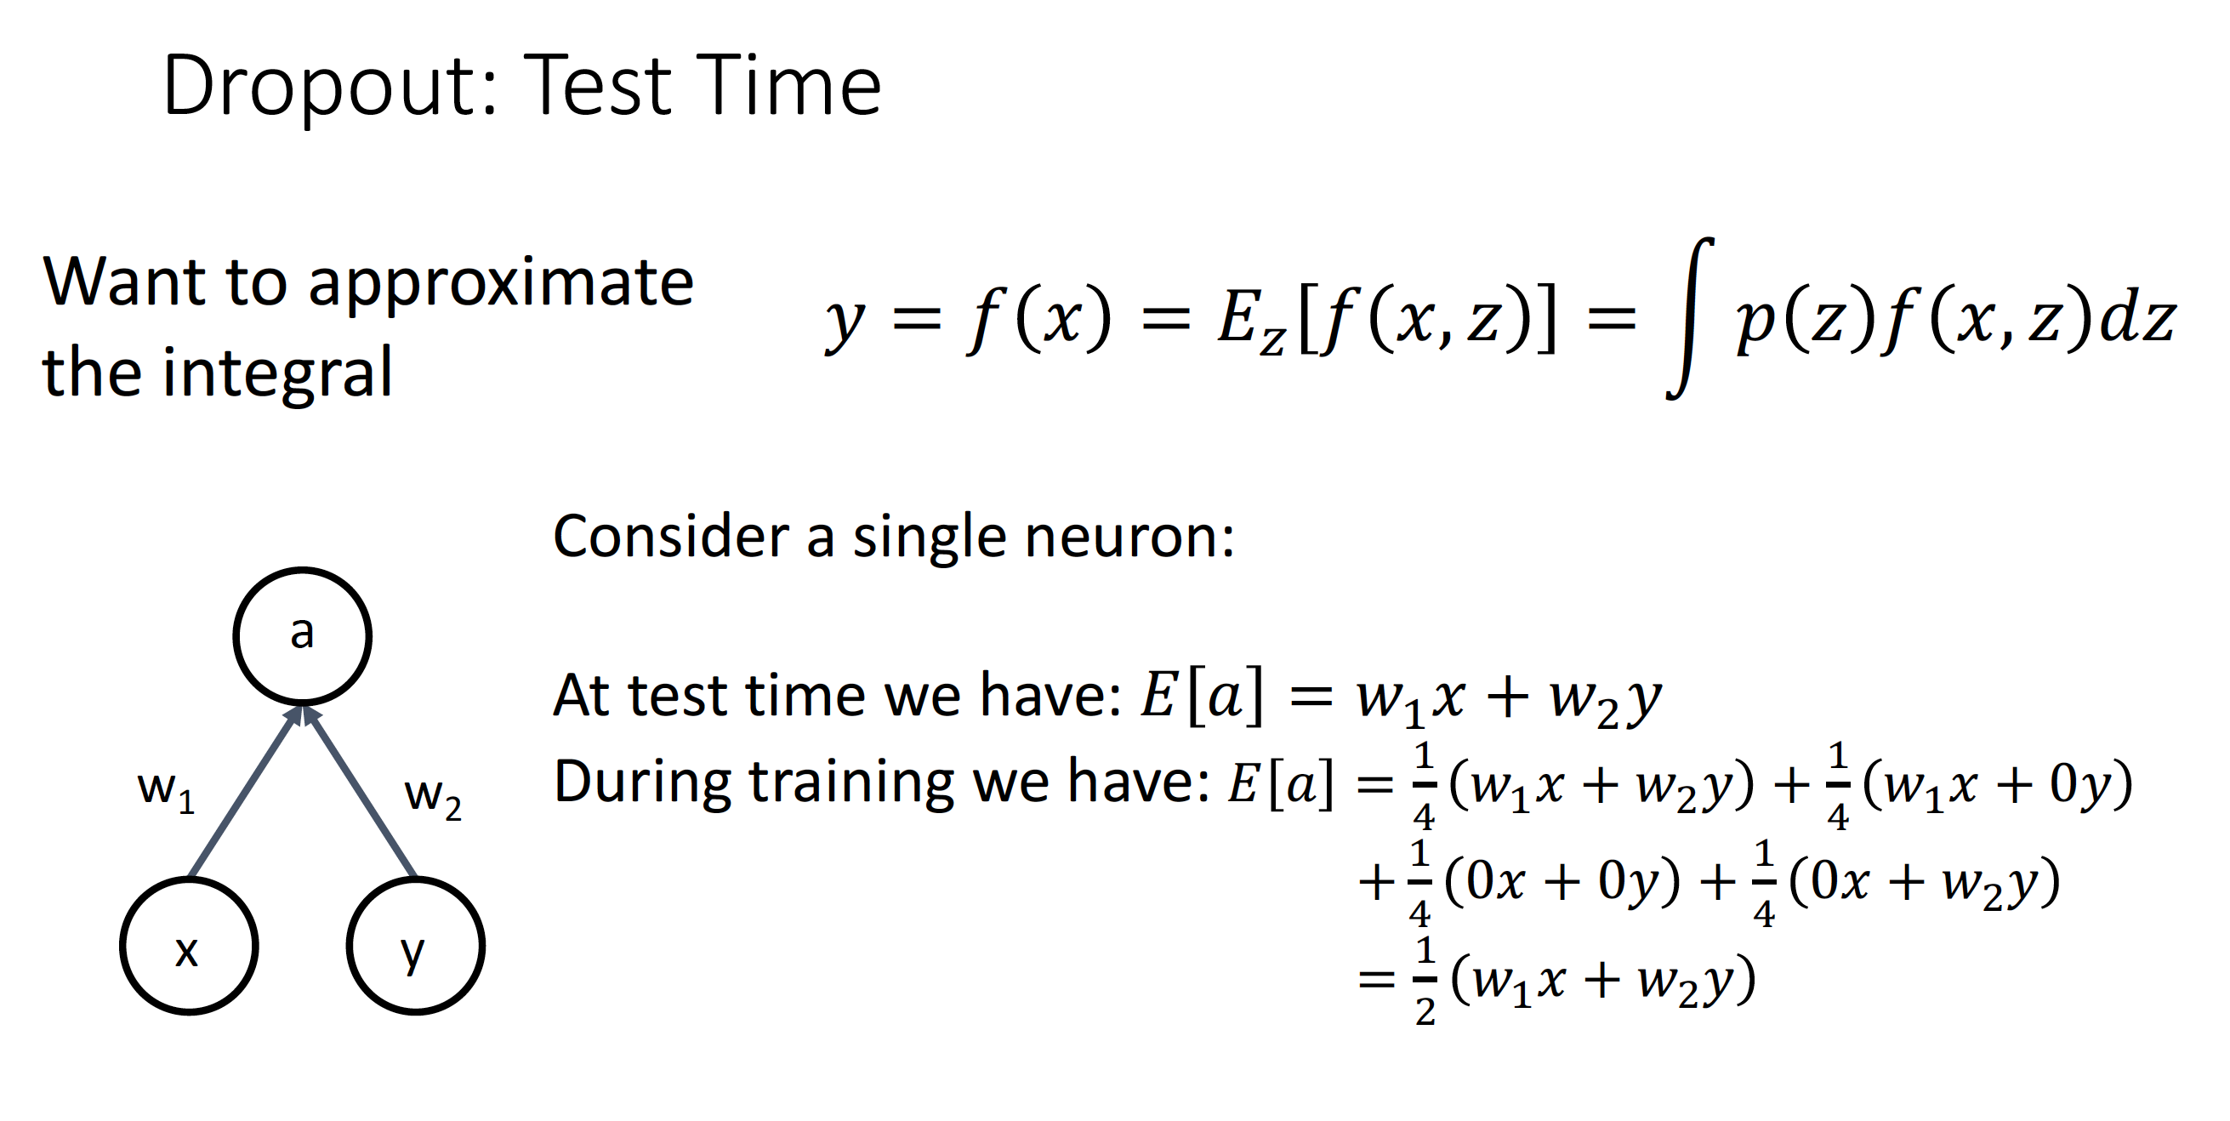

Slide 19
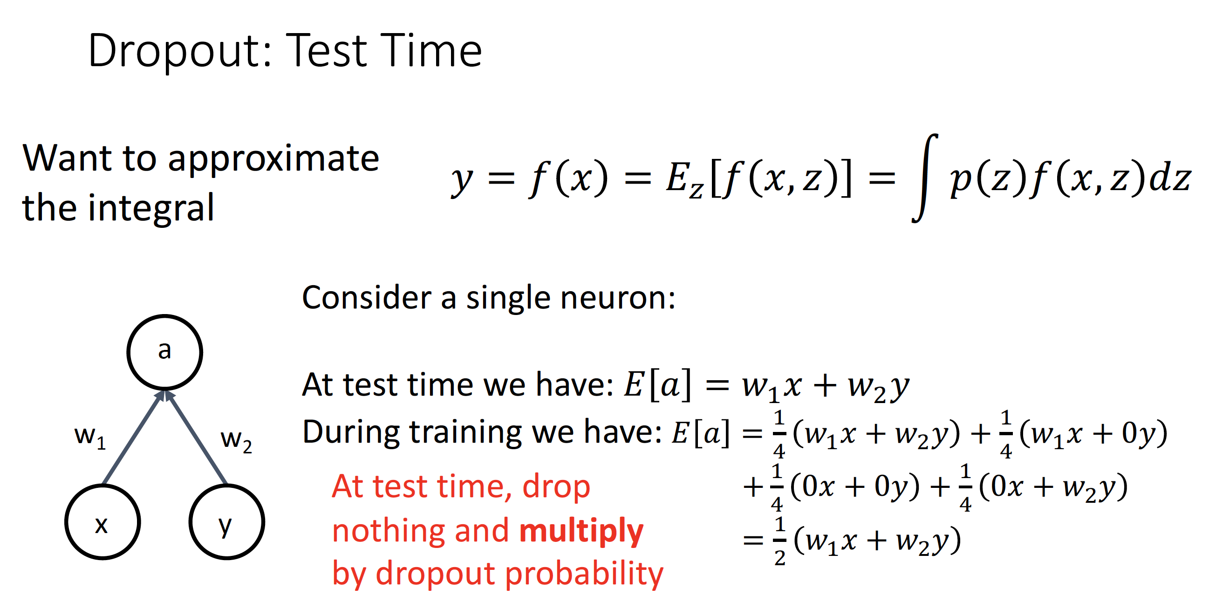

Slide 20
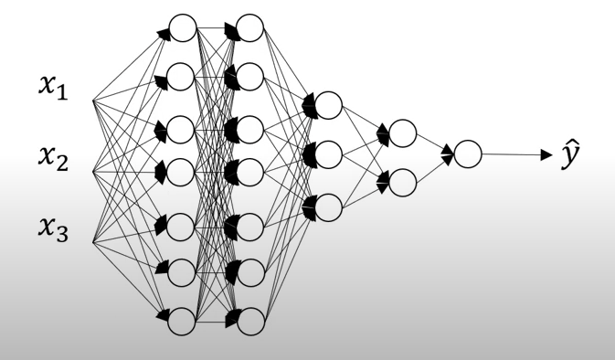
Where you do the Dropout
1.0
1.0
0.8
0.5
0.5

Slide 21

Where you do the Dropout
Recall AlexNet, VGG have most of their parameters in fully-connected layers; usually Dropout is applied there
AlexNet vs VGG-16
(Params, M)
Dropout here!
120000
100000
80000
60000
40000
20000
0
conv1 conv2 conv3 conv4 conv5
AlexNet VGG-16
fc6 fc7 fc8

Slide 22
Where you do the Dropout
Recall AlexNet, VGG have most of their parameters in fully-connected layers; usually Dropout is applied there
AlexNet vs VGG-16
(Params, M)
Later architectures (GoogLeNet, ResNet, etc) use global average pooling instead of fully-connected layers: they don’t use dropout at all!
Dropout here!
120000
100000
80000
60000
40000
20000
0
conv1 conv2 conv3 conv4 conv5
AlexNet VGG-16
fc6 fc7 fc8

Slide 23
Regularization#3: Data Augmentation
Increase size of your training data (‘augmentation’), by various transformations.
Credit: Lazebnik, CS231n, source1, source2

Slide 24
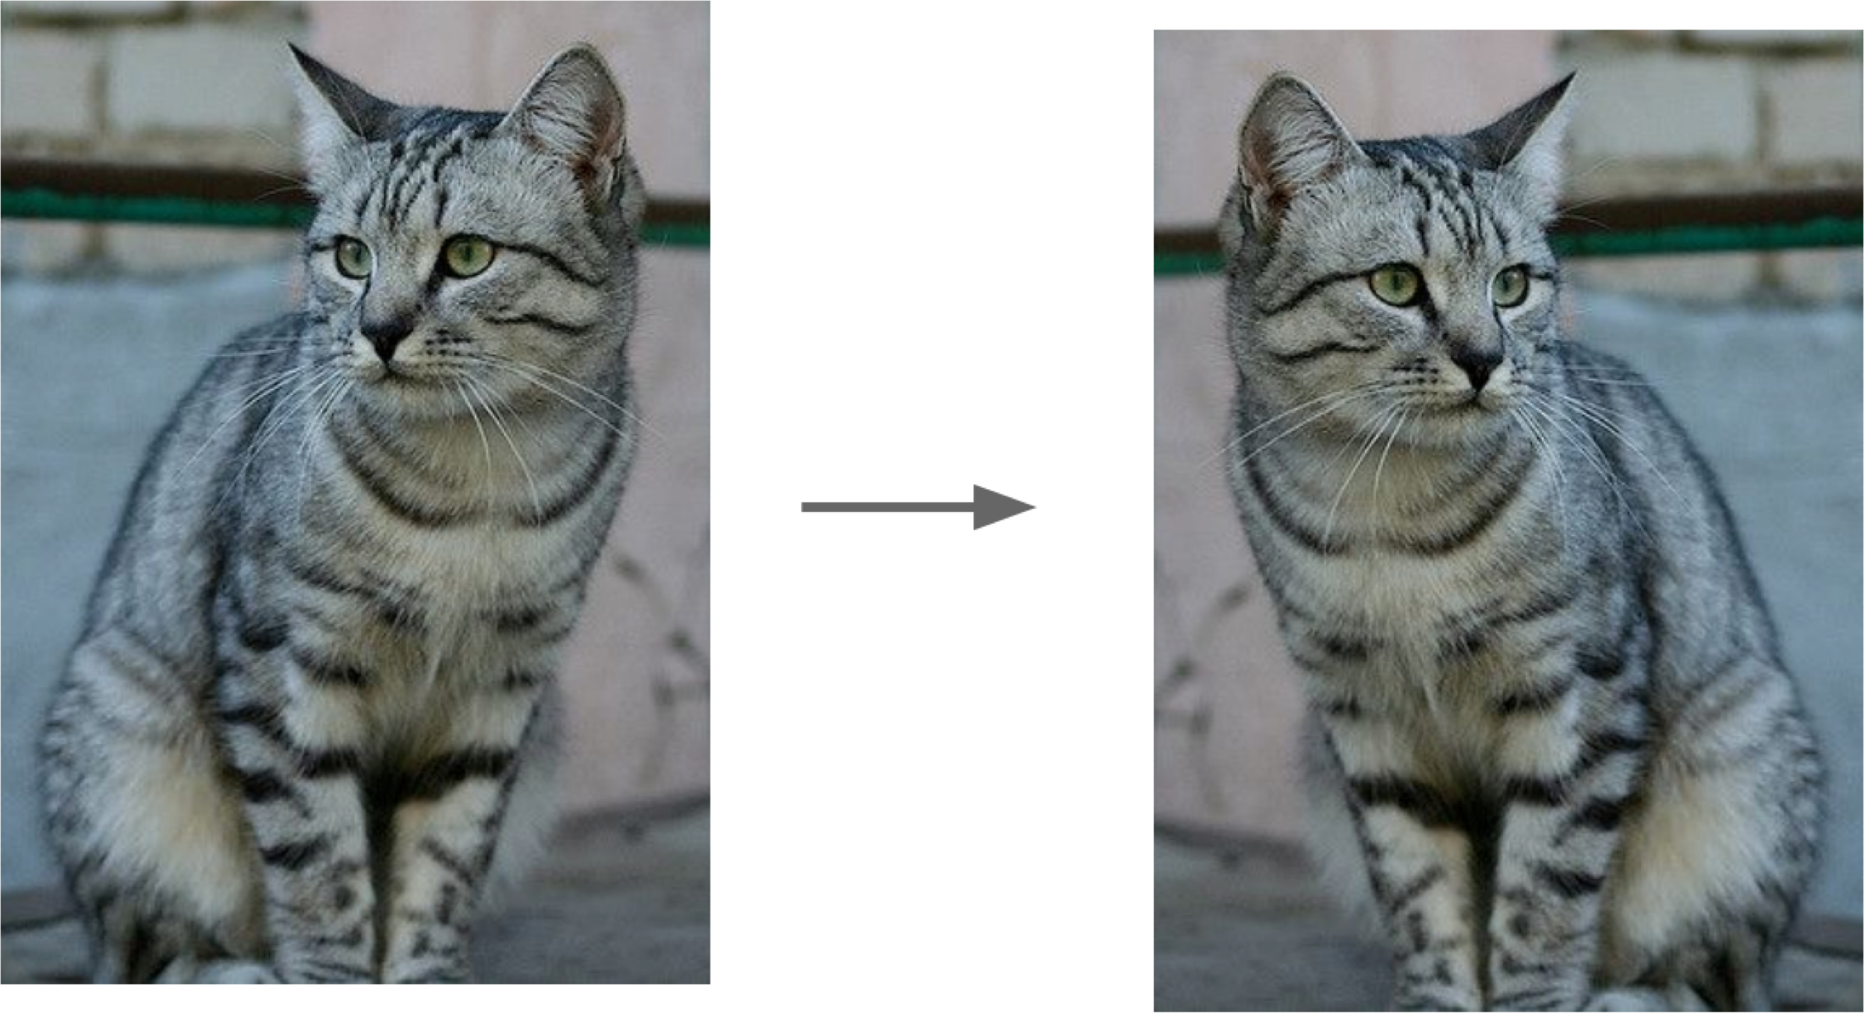
Data augmentation
Increase size of your training data (‘augmentation’), by various transformations.
Horizontal flips
Credit: Lazebnik, CS231n, source

Slide 25
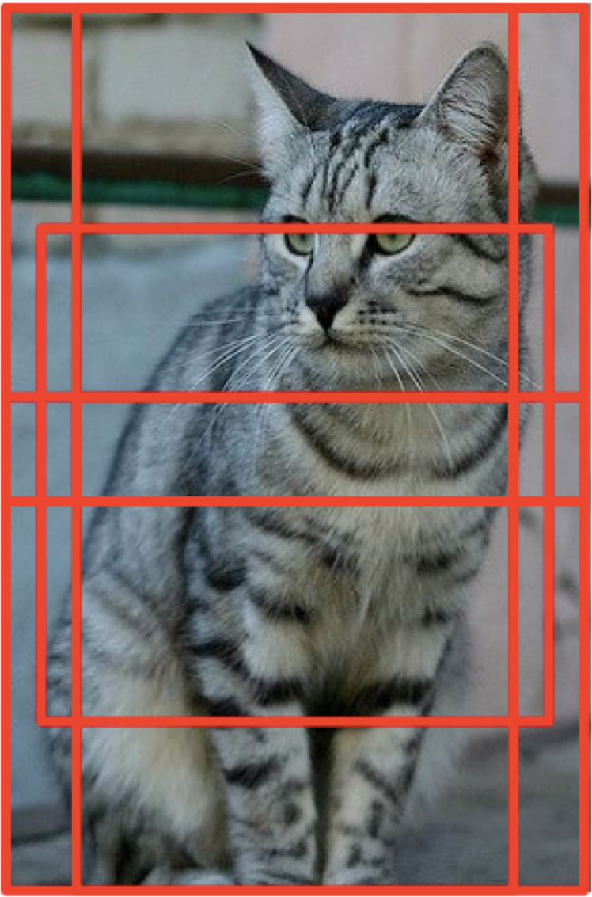

Data augmentation
Increase size of your training data (‘augmentation’), by various transformations.
Horizontal flips
Rotation, shearing
Random crops
Credit: Lazebnik, CS231n, source1, source2

Slide 26
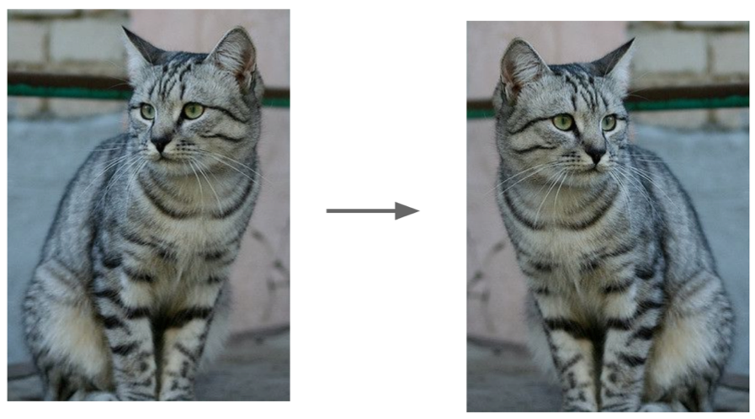
Data augmentation
Increase size of your training data (‘augmentation’), by various transformations.
Geometric: flipping, rotation, shearing, random crops
Credit: Lazebnik, CS231n, source1, source2

Slide 27
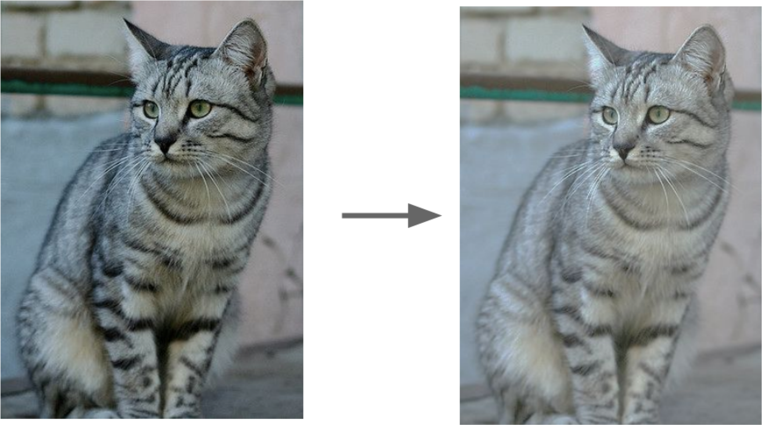
Data augmentation
Increase size of your training data (‘augmentation’), by various transformations.
Geometric: flipping, rotation, shearing, random crops
Photometric: color transformations
Credit: Lazebnik, CS231n, source

Slide 28

Data augmentation
Increase size of your training data (‘augmentation’), by various transformations.
Geometric: flipping, rotation, shearing, random crops
Photometric: color transformations
Other: add noise, compression artifacts, lens distortions, etc.
Credit: Lazebnik, CS231n, source

Slide 29
Regularization#4: Early Stopping
Stop here!
Validation Error
Error
Training Error
Epochs

Slide 30
Learning Rate Schedules

Slide 31
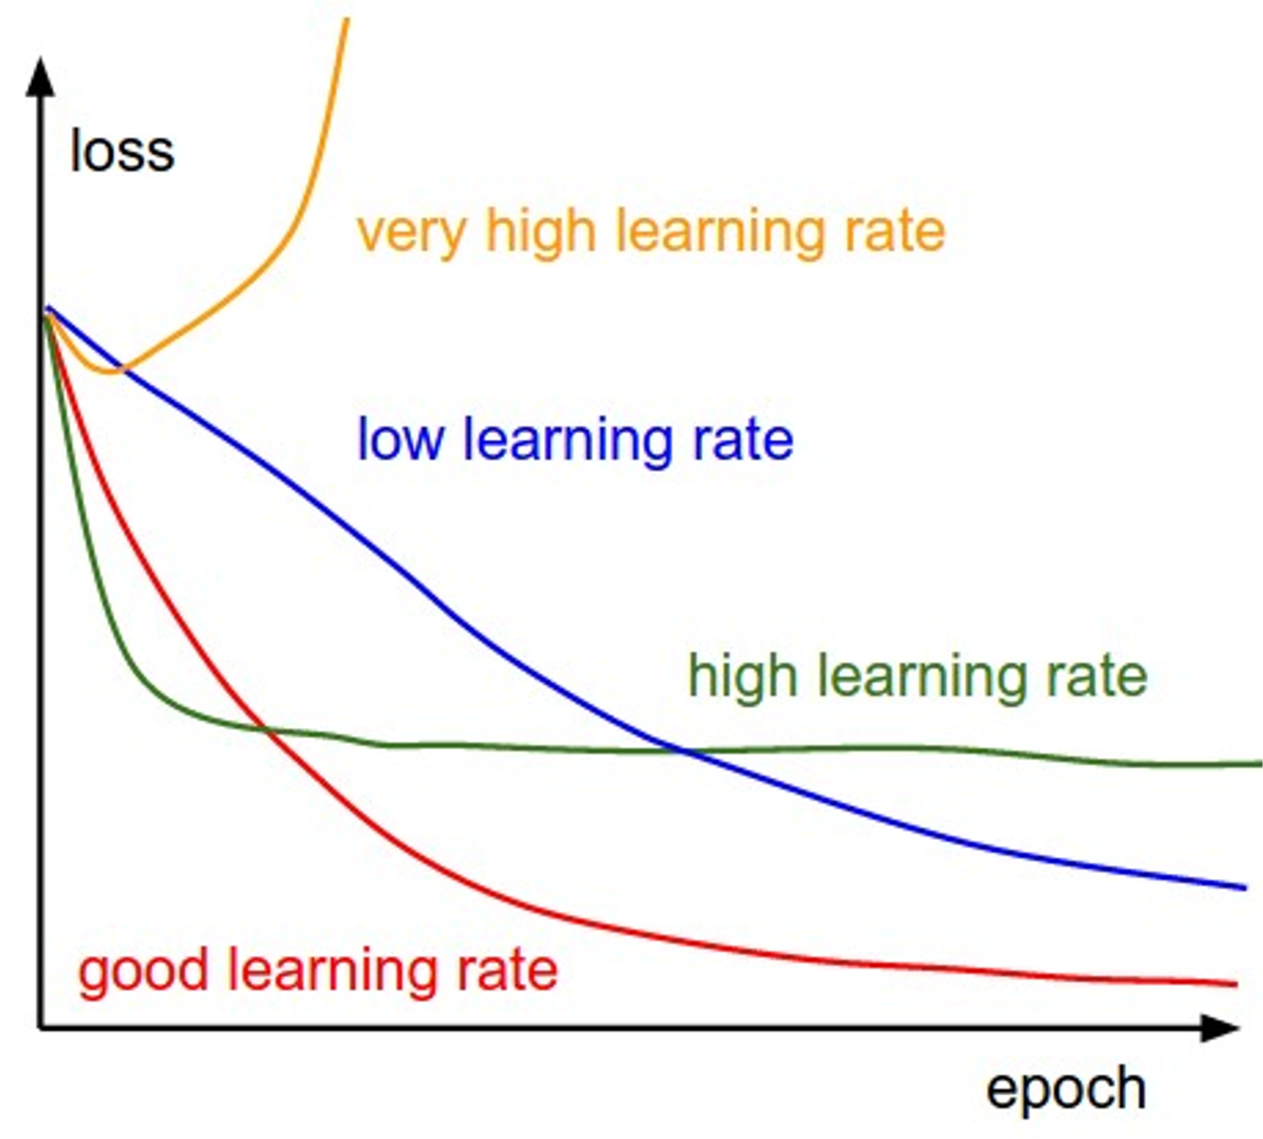
SGD, SGD+Momentum, Adagrad, RMSProp, Adam all have learning rate as a hyperparameter.

Slide 32
SGD, SGD+Momentum, Adagrad, RMSProp, Adam all have learning rate as a hyperparameter.
Q: Which one of these learning rates is best to use?

Slide 33
SGD, SGD+Momentum, Adagrad, RMSProp, Adam all have learning rate as a hyperparameter.
Q: Which one of these learning rates is best to use?
A: All of them! Start with large learning rate and decay over time

Slide 34
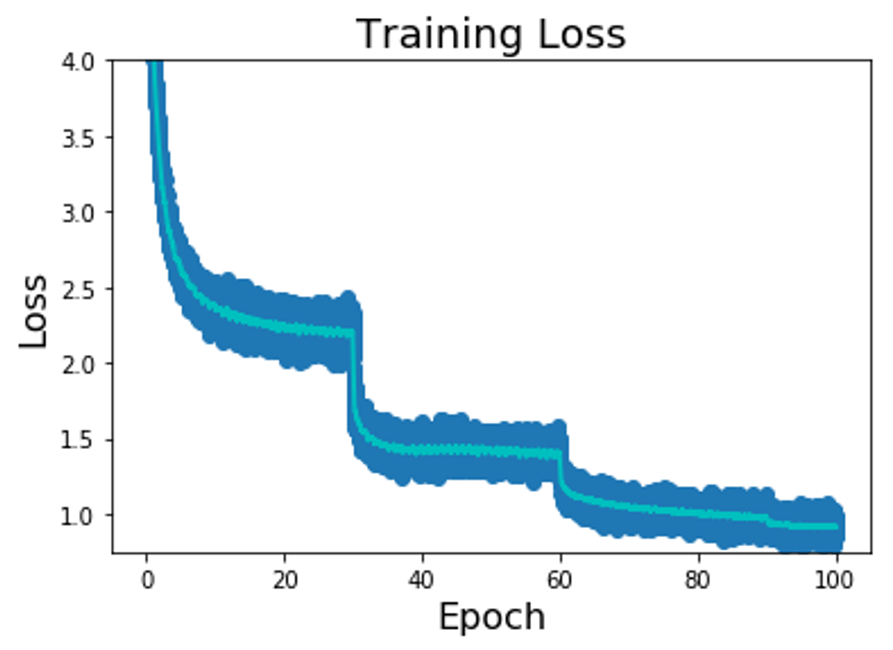
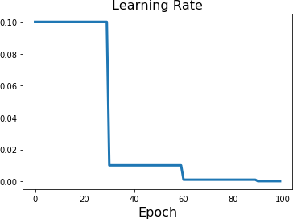
Learning Rate Decay: Step
Step: Reduce learning rate at a few fixed points.
Reduce learning rate
E.g. for ResNets, multiply LR by 0.1 after epochs 30, 60, and 90.

Slide 35
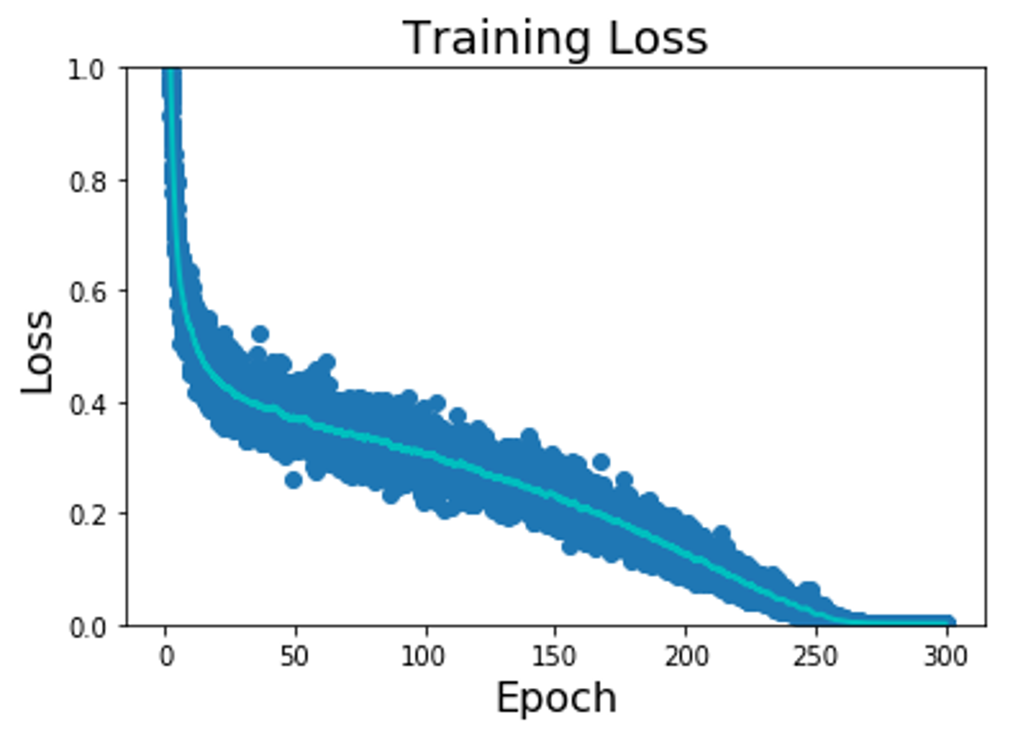
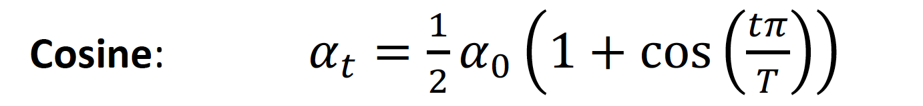
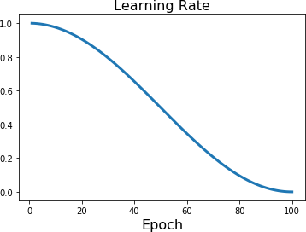
Learning Rate Decay: Cosine
Step: Reduce learning rate at a few fixed points.
E.g. for ResNets, multiply LR by 0.1 after epochs 30, 60, and 90.
Loshchilov and Hutter, “SGDR: Stochastic Gradient Descent with Warm Restarts”, ICLR 2017 Radford et al, “Improving Language Understanding by Generative Pre-Training”, 2018 Feichtenhofer et al, “SlowFast Networks for Video Recognition”, ICCV 2019
Radosavovic et al, “On Network Design Spaces for Visual Recognition”, ICCV 2019
Child at al, “Generating Long Sequences with Sparse Transformers”, arXiv 2019

Slide 36
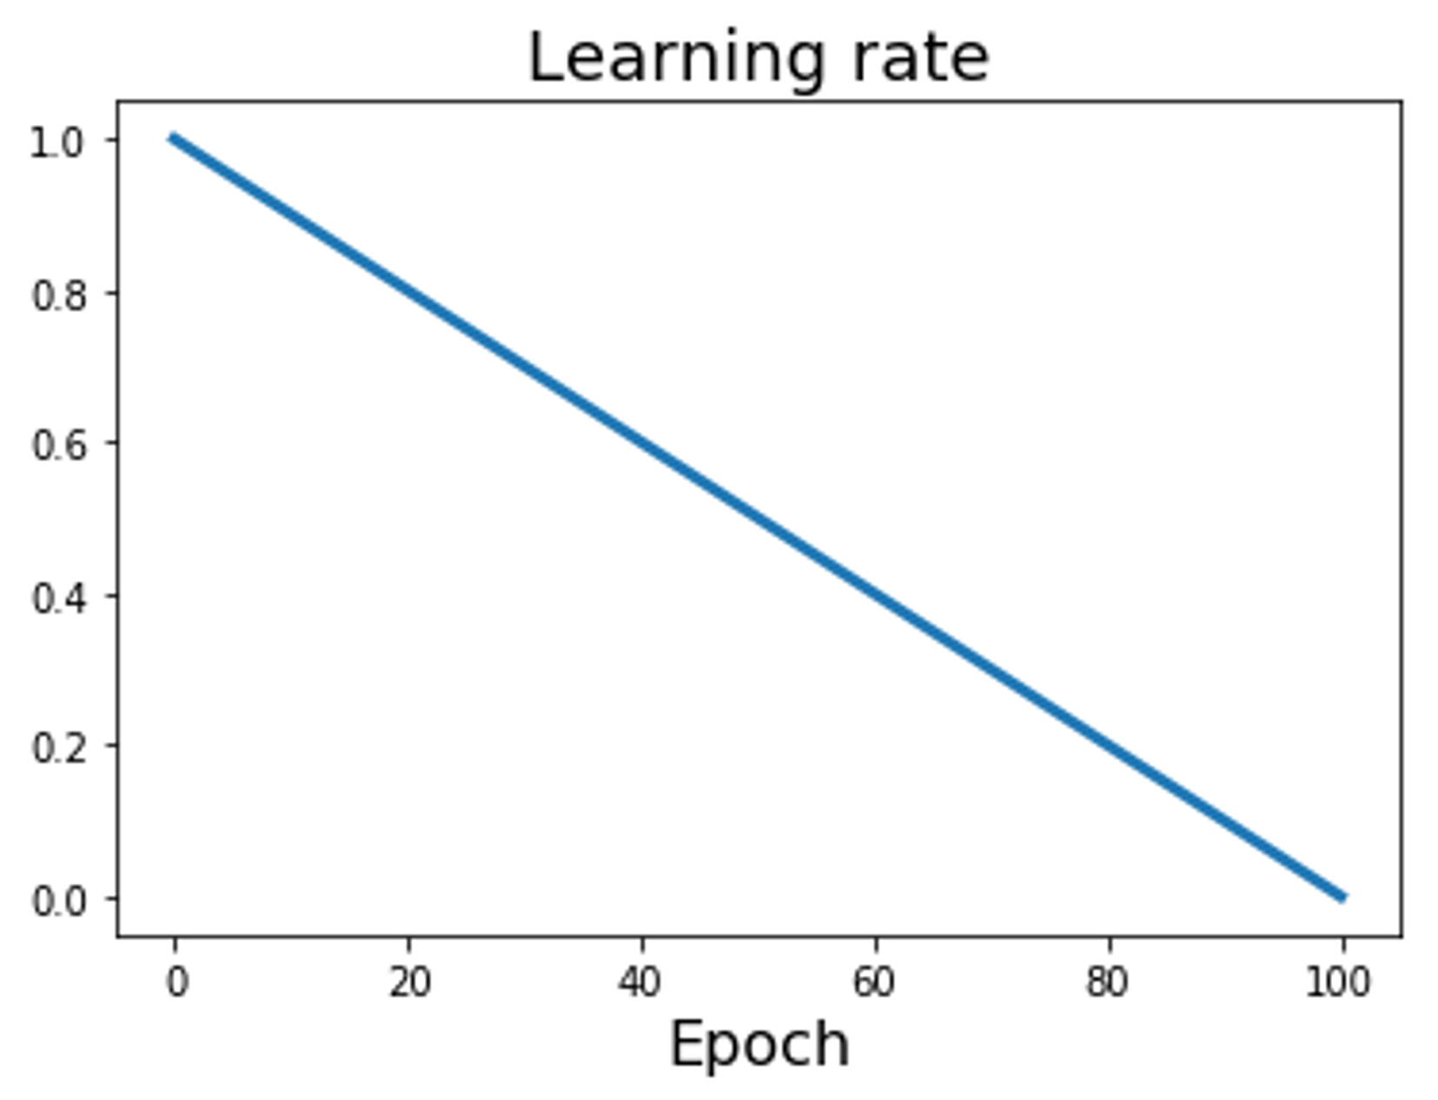
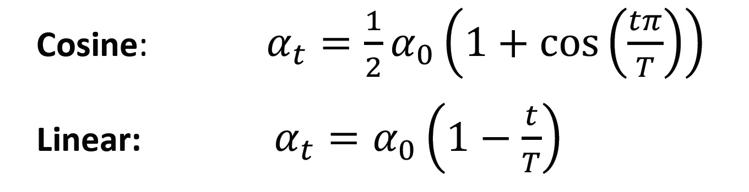
Learning Rate Decay: Linear
Step: Reduce learning rate at a few fixed points.
E.g. for ResNets, multiply LR by 0.1 after epochs 30, 60, and 90.

Slide 37
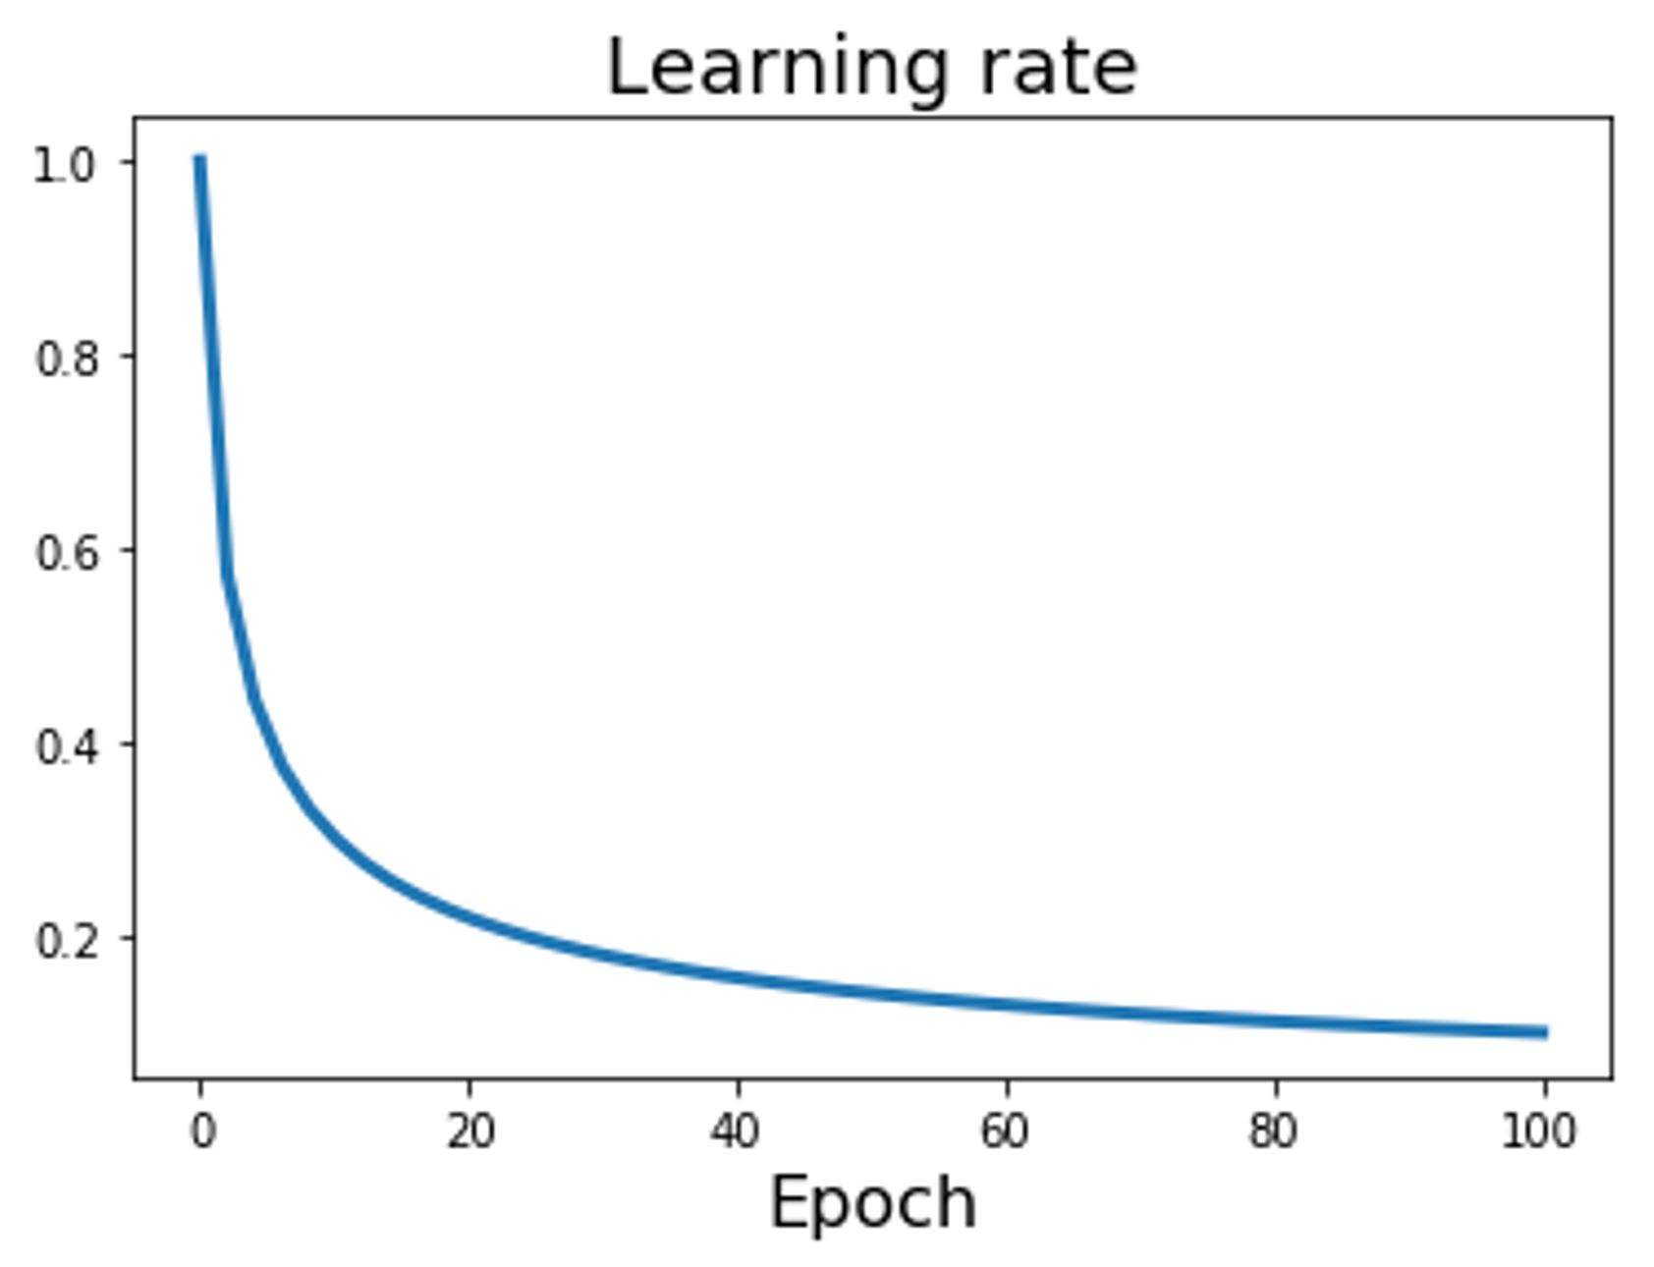
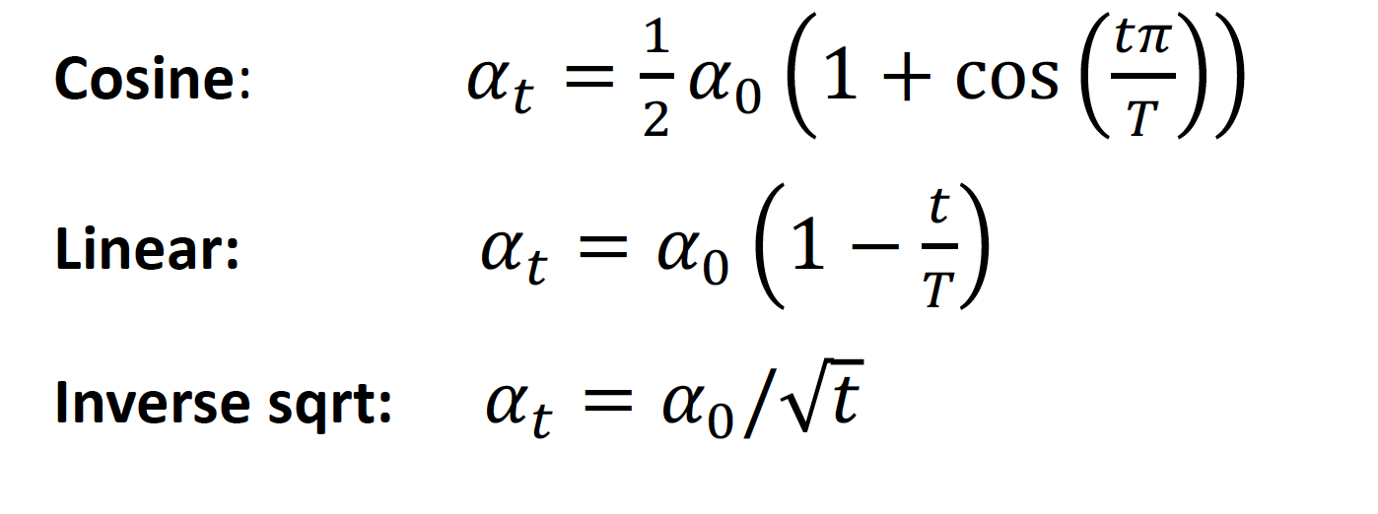
Learning Rate Decay: Inverse Sqrt
Step: Reduce learning rate at a few fixed points.
E.g. for ResNets, multiply LR by 0.1 after epochs 30, 60, and 90.

Slide 38
Any Question ?

